Slide 2
Presentation to the Company’s Shareholders
Anil Sardana
CEO & Managing Director
13th August, 2014

Slide 3
Agenda
About your Company
Key Highlights
Focus areas for your Company
People and Community
Awards and Recognition

Slide 4
About your Company

Slide 5
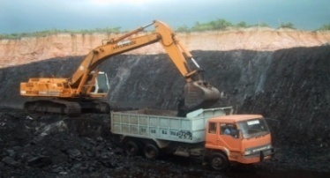
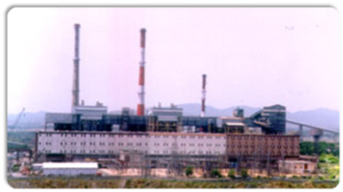
Integrated power utility with pan value chain presence
Play across the entire value chain
Fuel & Logistics
Generation
Transmission
Distribution & Supply
Stake in Indonesian mines
Two domestic captive coal mines being developed
Fuel supply in place for majority of operational and under-execution projects
Investment in Trust Energy for coal transportation
8,613 MW operational capacity
834 MW under construction in India and international geographies
Mumbai:
1,125 circuit km of Transmission lines and 20 receiving stations
Powerlinks:
1,200 km of line associated with Tala hydro project
Connects Bhutan and Northern Region
Mumbai distribution network
Over 5 lakh retail consumers
Delhi distribution
Over 14 lakh consumers

Slide 6
Expanding global footprint
Established/ in advanced stages
Early stages
Tata Power – Global presence
Hydro Projects - Bhutan
Coal fired project - Myanmar
Hydro Projects - Georgia
Coal fired project - Vietnam
Distribution Consultancy Assignment - Nigeria
Logistics Office - Singapore
Hydro Power- Zambia
JV for Power Projects – South Africa
Coal Mines, Geothermal Project – Indonesia
Technology Investments - Australia
Early success in each of our focus geographies.
Strategy aimed at mitigating prevailing domestic challenges viz. land, fuel, etc.

Slide 7
Operating Performance – Standalone and Key Subsidiaries
Operating Profit of key entities (` crore)
Note: TPSSL – 100% Operating Profit is shown for all the years

Slide 8
Standalone Financials – FY14
Figures in ` Crore | FY14 | FY13
Net Sales/Income from Other Operations | 8,627 | 9,567
Operating Expenditure | 6,073 | 7,509
Operating Profit | 2,554 | 2,058
Less: Forex Loss | 264 | 28
Add: Other Income | 656 | 722
Less: Finance Cost | 868 | 684
Profit Before Depreciation and Tax | 2,078 | 2,067
Less: Depreciation/Amortization/Impairment | 587 | 364
Profit Before Tax | 1,491 | 1,703
Tax Expenses | 537 | 679
Net Profit/(Loss) After Tax¹ | 954 | 1,025
1- Before Interest on Perpetual Bonds

Slide 9
Consolidated Financials – FY14
Figures in ` Crore | FY14 | FY13
Net Sales/Income from Other Operations | 35,649 | 33,025
Operating Expenditure | 27,942 | 26,386
Operating Profit | 7,707 | 6,639
Less: Forex Loss | 789 | 188
Add: Other Income | 227 | 369
Less: Finance Cost | 3,440 | 2,642
Profit Before Depreciation and Tax | 3,705 | 4,178
Less: Depreciation/Amortization/Impairment | 2,730 | 2,901
Profit Before Tax | 975 | 1,277
Tax Expenses (Domestic) | 689 | 758
Tax Expenses (International) | 319 | 420
Net Profit/(Loss) After Tax | (33) | 99
Less: Minority Interest | 272 | 208
Add: Share of Profit of Associates | 45 | 24
Net Profit After Tax, Minority Interest and Share of Profit of Associates | (260) | (85)

Slide 10
Standalone Financials – Q1 FY15
Figures in ` Crore | Q1-FY15 | Q1-FY14
Net Sales/Income from Other Operations | 2,328 | 2,608
Operating Expenditure | 1,780 | 1,865
Operating Profit | 548 | 743
Less: Forex Loss | 43 | 66
Add: Other Income | 265 | 246
Less: Finance Cost | 252 | 237
Profit Before Depreciation and Tax | 518 | 686
Less: Depreciation/Amortization/Impairment | 142 | 136
Profit Before Tax | 376 | 550
Tax Expenses | 120 | 193
Net Profit/(Loss) After Tax¹ | 256 | 357
1- Before Interest on Perpetual Bonds

Slide 11
Consolidated Financials – Q1 FY15
Figures in ` Crore | Q1-FY15 | Q1-FY14
Net Sales/Income from Other Operations | 8,766 | 9,339
Operating Expenditure | 6,991 | 7,272
Operating Profit | 1,775 | 2,068
Less: Forex Loss | 137 | 293
Add: Other Income | 86 | 65
Less: Finance Cost | 934 | 903
Profit Before Depreciation and Tax | 790 | 936
Less: Depreciation/Amortization/Impairment | 543 | 651
Profit Before Tax | 247 | 286
Tax Expenses (Domestic) | 256 | 232
Tax Expenses (International) | 58 | 103
Net Profit/(Loss) After Tax | (67) | (49)
Less: Minority Interest | 58 | 69
Add: Share of Profit of Associates | 14 | 3
Net Profit After Tax, Minority Interest and Share of Profit of Associates | (111) | (115)
If Compensatory Tariff of CGPL for Q1-FY15 is accounted, then the Net Profit After Tax, Minority Interest and Share of Profit of Associates would have been higher by ` 225 crore

Slide 12
Tata Power Stock Performance
April 2013 – till date: normalized chart
1 Apr 2013 value
18,891
1,645
95.15
Million
Note: Information updated as of 31 July 2014

Slide 13
Key Highlights

Slide 14
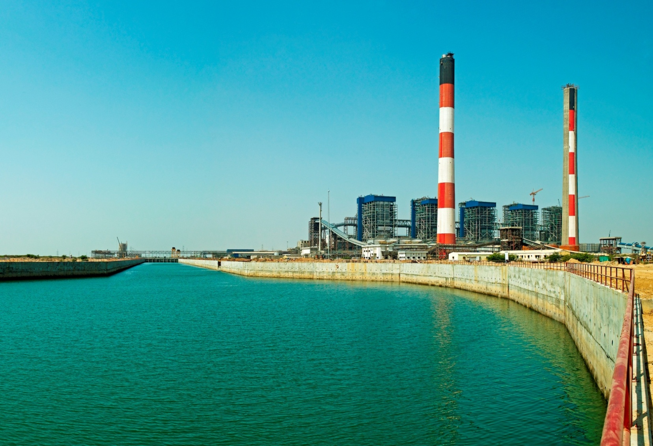
Mundra (4,000 MW)
2011
Change in Indonesian laws leading to CGPL being unable to recover the full cost of fuel through its tariff
Efforts made to resolve the issue through discussions with Govt. of Indonesia and procurers in India – however, issue persisted
CGPL submitted a petition to CERC seeking relief
CERC passed an order on 21st Feb, 2014 ruling that the company will be entitled to compensatory tariff to offset additional fuel costs
Procurers challenged the CERC order before the ATE and hearing has commenced
ATE has allowed CGPL to recover power dues from March 2014
2012
2014

Slide 15
Mumbai Distribution
Tata Power’s Distribution License to supply power in Mumbai expires in August 2014
MERC, through a public notice on 1st Jan, 2014 invited applications for Expression of Interest (EoI) from parties wished to distribute electricity in the area where Tata Power distributes electricity subsequent to expiry of its license
Based on MERC’s procedure, the formal process of public hearing and evaluation is currently in progress
In addition, Hon’ble Supreme Court has dismissed the appeal filed by BEST seeking to restrain Tata Power from laying its network to supply power to consumers in BEST License Area

Slide 16
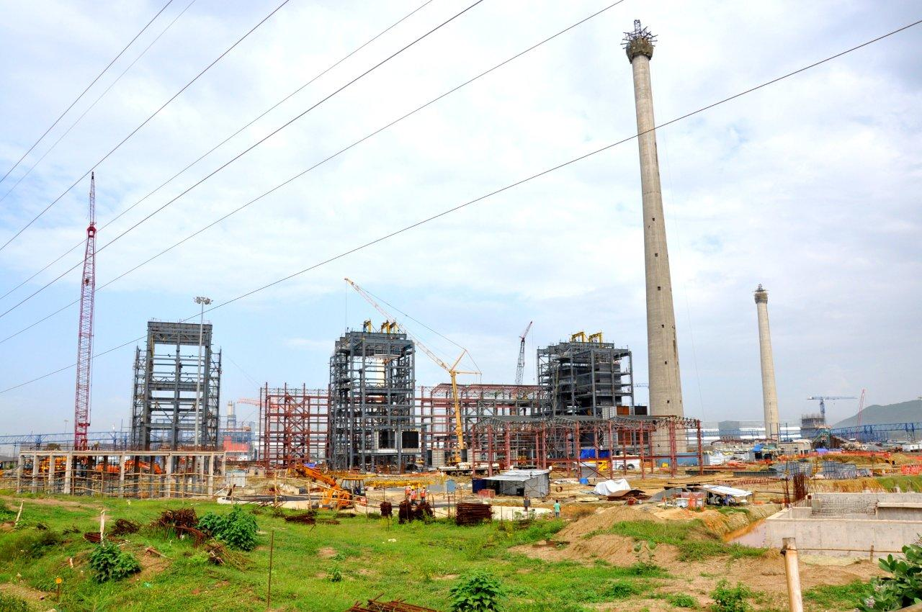
Kalinganagar (202.5 MW)
Project being executed through IEL, a JV of Tata Power (74%) and Tata Steel Limited (26%)
Project is in advanced stages of execution

Slide 17
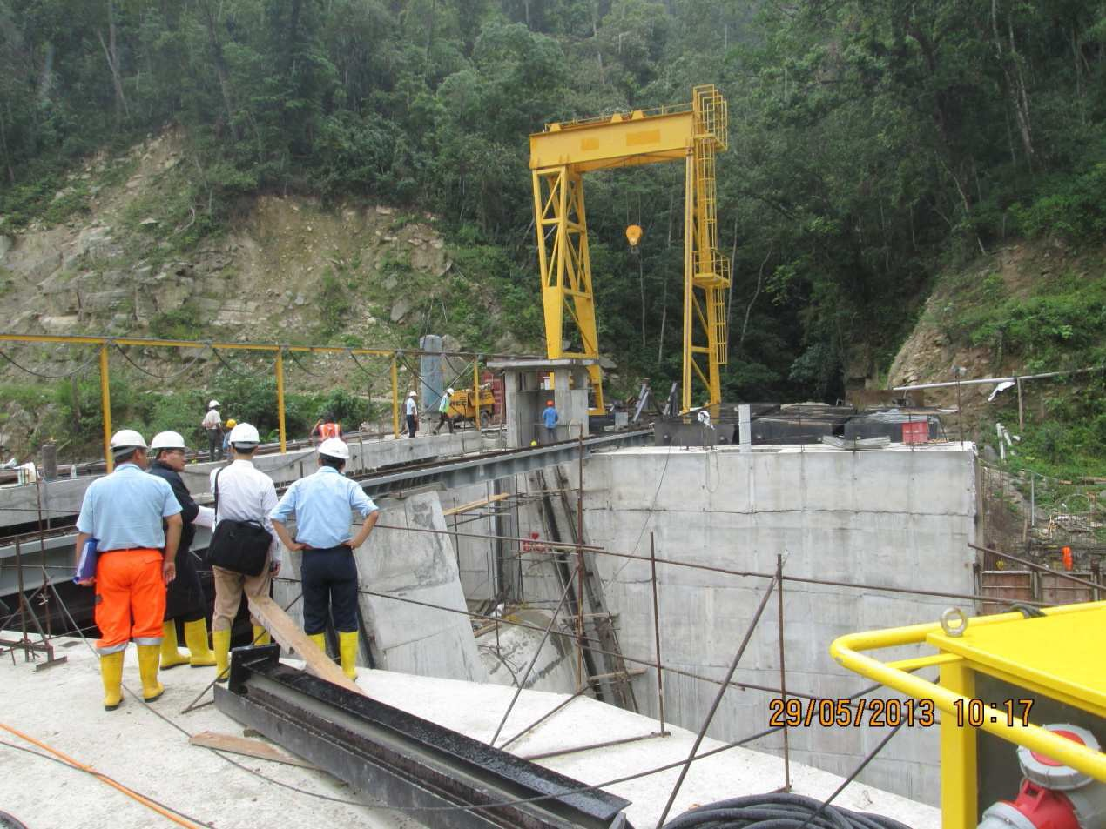
Dagacchu (126 MW)
Being implemented by Dagacchu Hydro Power Corporation Ltd., a JV of Tata Power (26%), Druk Green Power Corporation Ltd. (59%) and National Pension and Provident Fund of Bhutan (15%)
Project is in advanced stages of execution and likely to be completed before end of H1-FY15

Slide 18
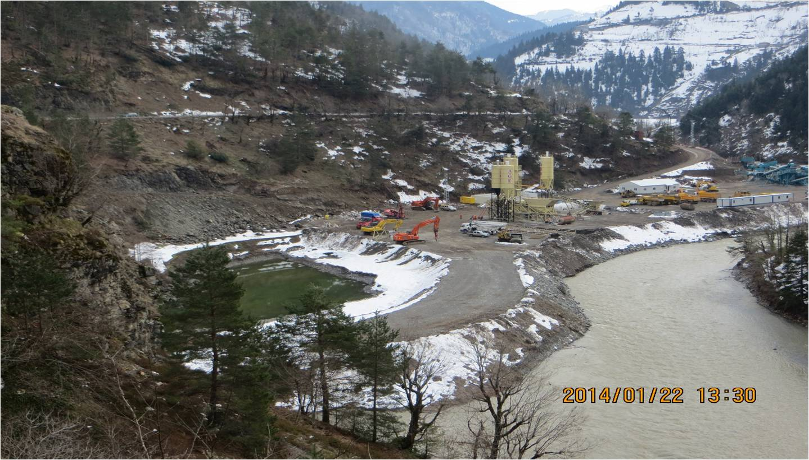
Georgia (400 MW)
Being implemented through Adjaristsqali Georgia LLC, a wholly owned subsidiary of Adjaritsqali Netherlands BV, where Tata Power holds 40% stake
Construction of 185 MW Shuakhevi Hydro Project has commenced with all major contracts awarded
Activities to achieve financial closure at an advanced stage
In addition, pre-development work on 150 MW Koromkheti Hydro Project has commenced

Slide 19
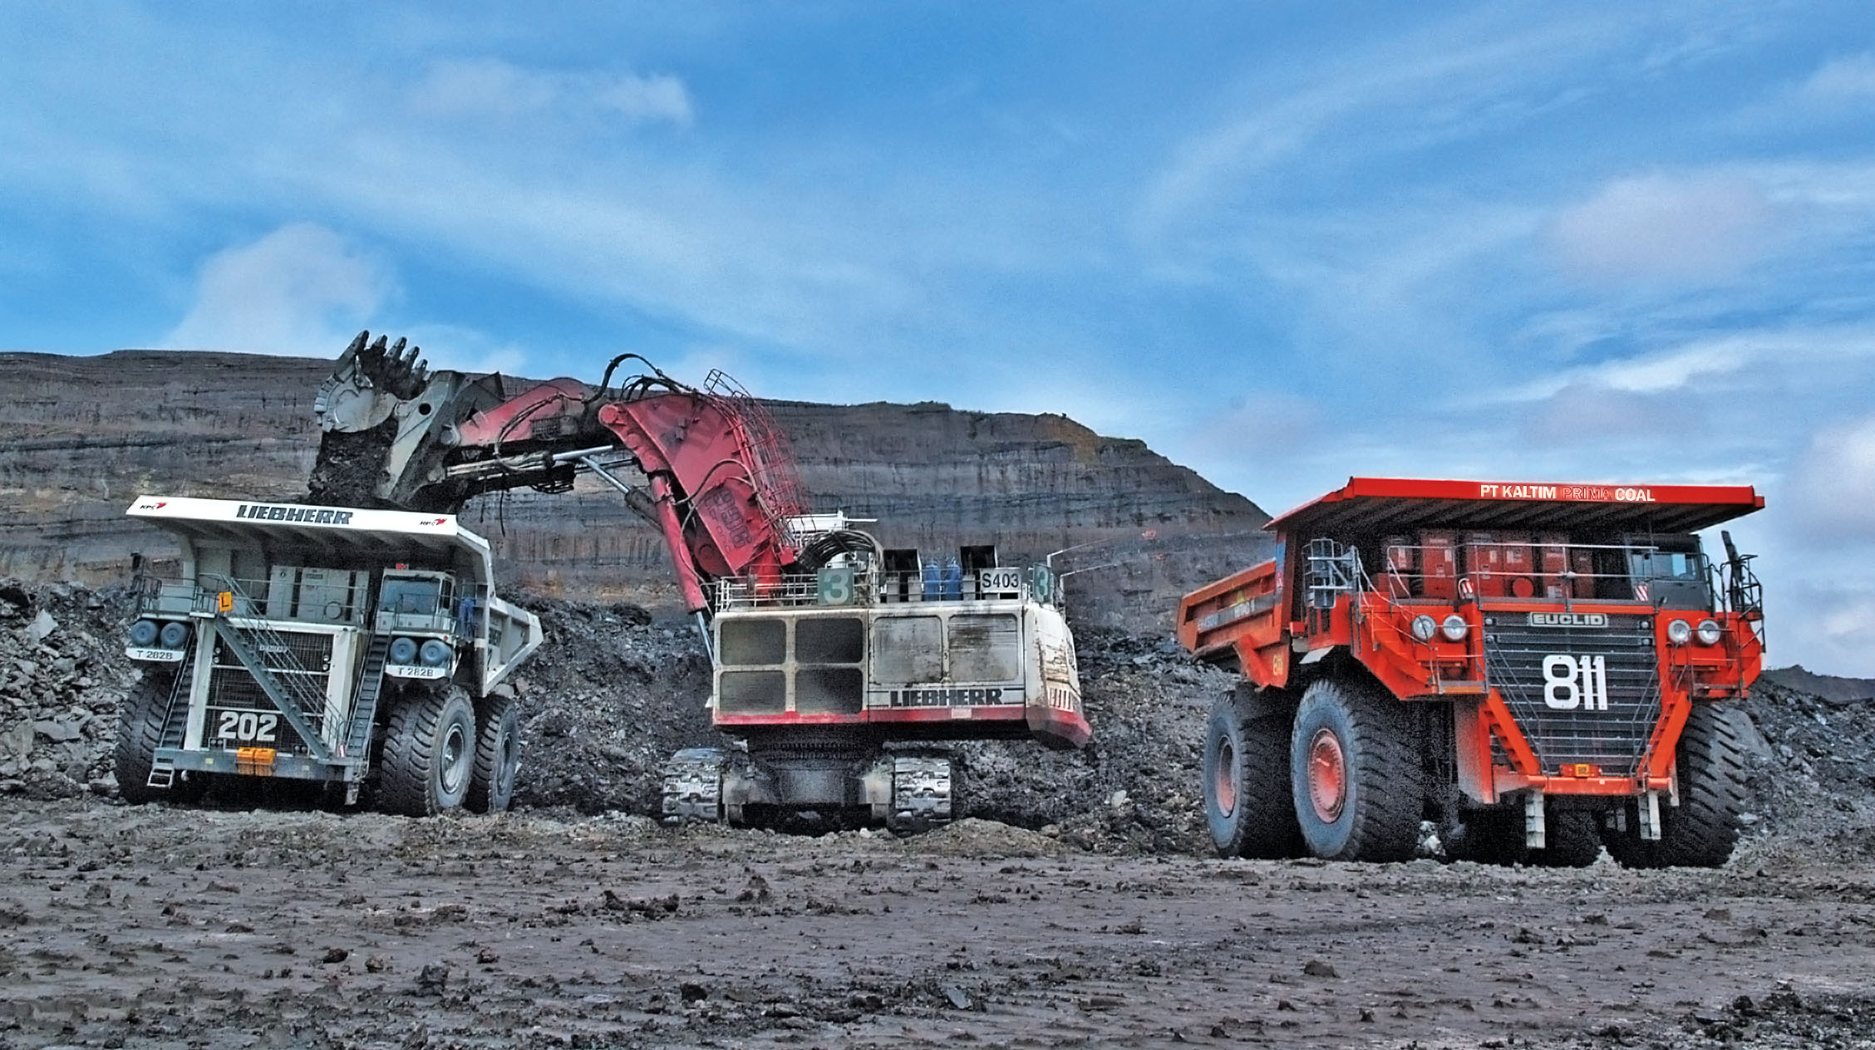
Coal Companies
Arutmin
Your Company has signed an agreement to sell its 30% stake in PT Arutmin Indonesia and associated companies in coal trading and infrastructure
Aggregate consideration for Tata Power’s stake is USD 510 million
Conditions precedent to deal being closed
Kaltim Prima Coal (KPC)
Your Company has signed options agreement to sell 5% stake in KPC
This is aimed at getting additional cash as well as to reduce the Company’s consolidated debt

Slide 20
Treasury and Investments
Rights Issue
Rights Issue of ` 1,993 crore launched during the year and successfully closed
Issue price of ` 60 per share
The Issue was over subscribed 1.96 times – largest ever in the history of an issue of this magnitude
Positive movement of stock in the market leading to value creation for shareholders

Slide 21
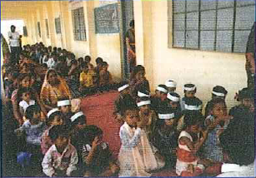
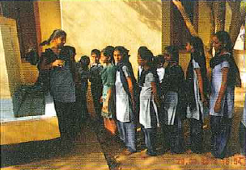
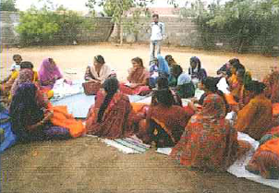
Sustainability – Key Thrust Areas
Vidya… augmenting primary education system
Arogya & Swachch Jal… building and strengthening health care facilities
Education
Health
Sustainability
Inclusive Growth
Livelihood
Infrastructure
Akshay… nurturing sustainability for inclusive growth
Samriddhi & Daksh… enhancing programmes on livelihood & employability
Sanrachna… building social capital & infrastructure

Slide 22
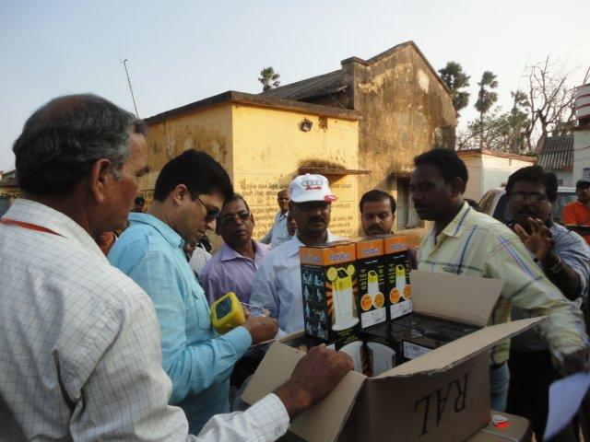
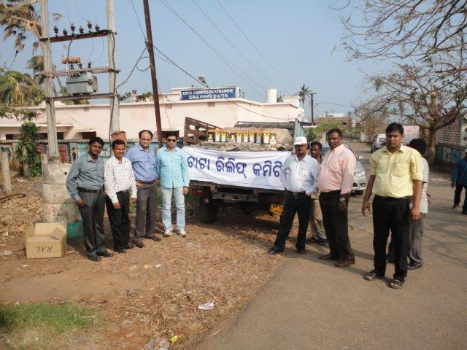
Relief efforts for natural calamities
Relief efforts undertaken in Orissa for floods due to Cyclone Phailin
Continued effort to rebuild Uttarakhand since 2013
Commitment to Sustainability and CSR for Tata Power goes beyond the statutory requirements

Slide 23
Focus areas for your Company

Slide 24
Key focus areas in the near term
Resolution of CGPL tariff issue
Case currently being heard by ATE
Continued development of renewable energy
Consolidating Mumbai business
Generation – PPA renewal for Unit-6, Revival of Unit-8
400 KV Vikhroli Transmission Line
Network expansion in Distribution
Project development & execution
Domestic:Kalinganagar, Dagacchu, Dehrand, Mundra Expansion, Maithon Phase II, Dugar, coal blocks and end use plants
International:Cennergi, Georgia, Zambia, Vietnam, Myanmar
Long Term Open Access for power transmission between Maithon Power Ltd. and Kerala State Electricity Board
Readiness for implementation of Companies Act, 2013 (including CSR commitment and other provisions)

Slide 25
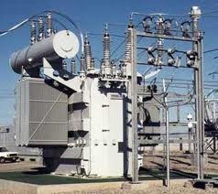
Long Term Strategic Intent (2022) revisited in 2014
18,000 MW
with
20-25% from clean and green sources
25 MTPA
4,000 MW
10X growth
Generation
Fuel
(Coal & Equivalent)
Distribution & DDG
Value Added Businesses
Services, Trading,
Solar Systems, SED,
CTTL

Slide 26
Your Company is engaging with the new Government to address the sectoral issues paving way for development
Energy Security for power in India
Viability of Distribution Sector
Creating a level playing field for Public & Private Sector Players
Transmission Infrastructure
Addressing challenges in land acquisition & statutory clearances (MoEF, etc)
As laid out in the Union Budget, the Government is focusing on fuel availability, logistics infrastructure, tax incentives, solar energy, Transmission & Distribution network development

Slide 27
People and Community

Slide 28
Key People Statistics
Employee Count
Employee Engagement (determined through a Aon Hewitt survey in 2013) is 67% as against industry average of 66%
Several initiatives undertaken for
Capability Development
Talent Management
Succession Planning
Maintaining good industrial relations
Institutionalizing policy for Prevention, Prohibition and Redressal of Sexual Harassment at workplace (POSH) in line with requirements of Companies Act, 2013
Total Employee Base of approx 6,000
Age Wise Distribution of Management Personnel

Slide 29
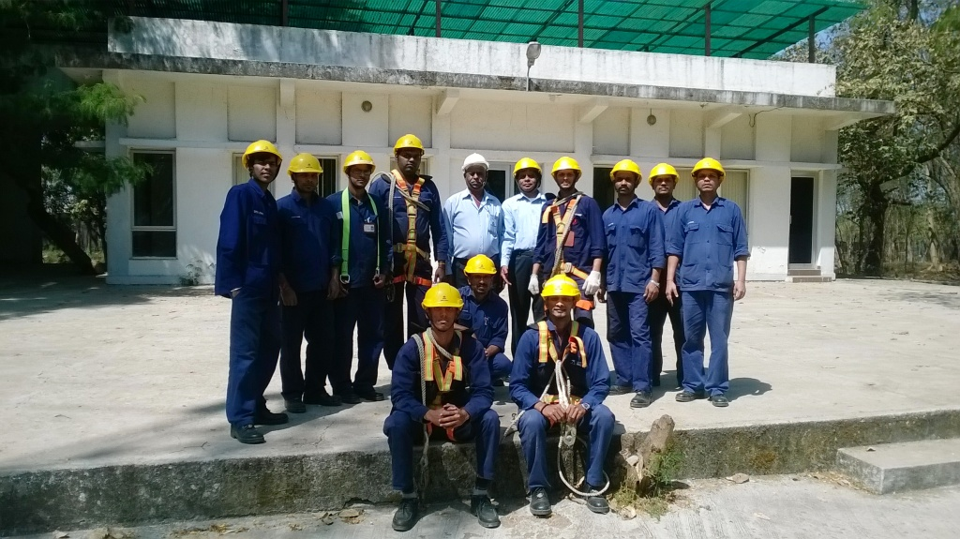
Skill Development Institute
Aimed at meeting the national needs for large scale skilled workforce for the future
Tata Power Skill Development Institute (TPSDI) will impart modular power skills training, testing, certification and accreditation in a phased manner
Focus would be on contractors’ work force of Tata Power initially
Over time, TPSDI would cater to other companies in the power sector

Slide 30
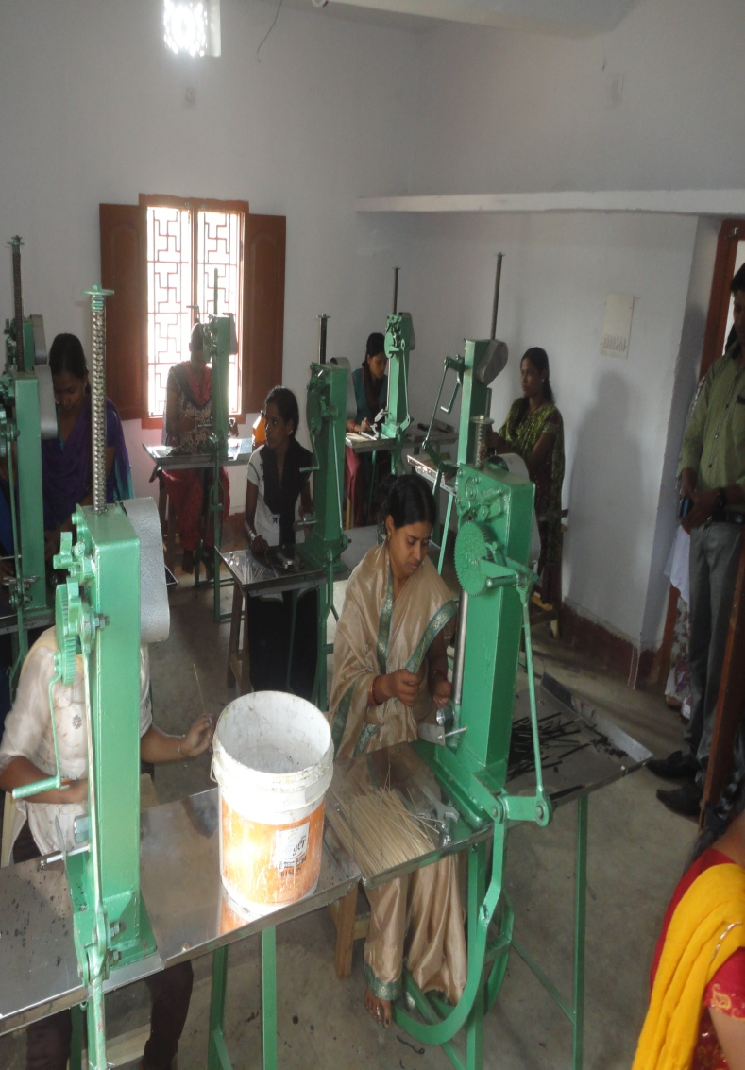
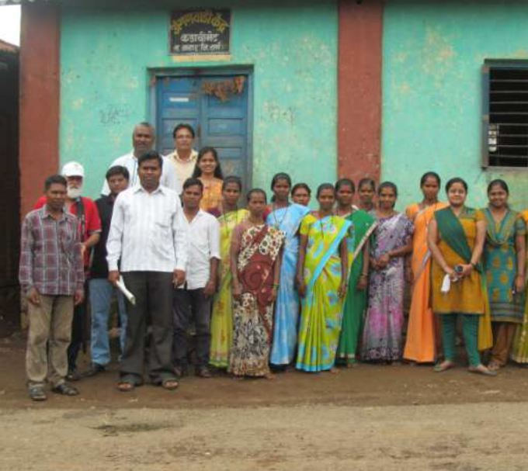
Affirmative Action
Several programs for the 4Es (Employment, Entrepreneurship, Employability and Education) implemented benefiting over 10,500 persons
Tata Power is also working in Jawahar Taluka in Thane District of Maharashtra, which has 90% tribal population – engaging with a tribal residential school, a Government ITI through employee volunteering and BOP training in association with TCS

Slide 31
Awards and Recognition

Slide 32
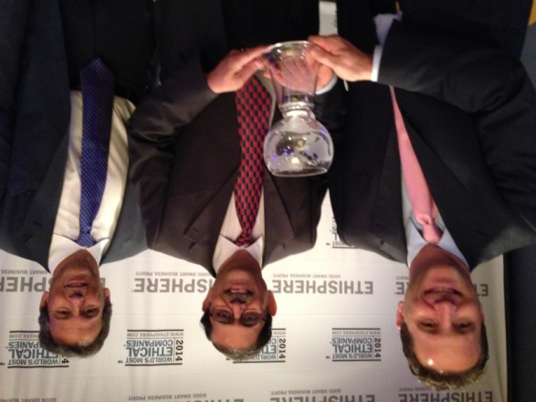
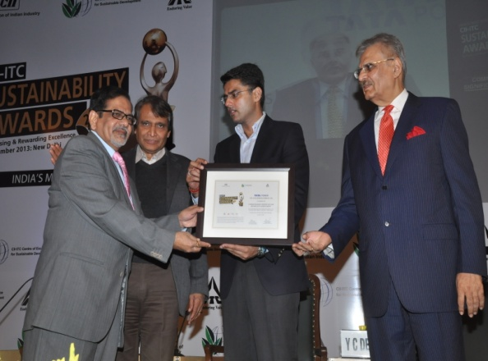
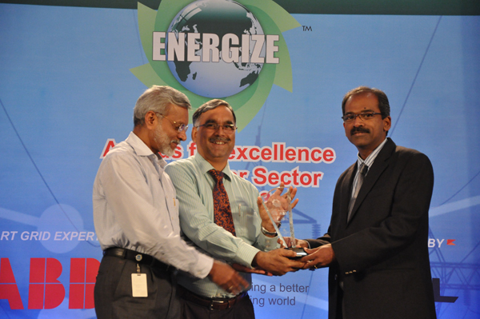
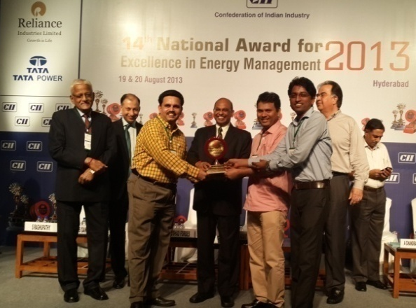
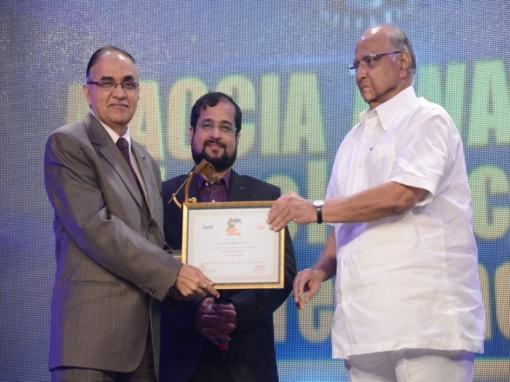
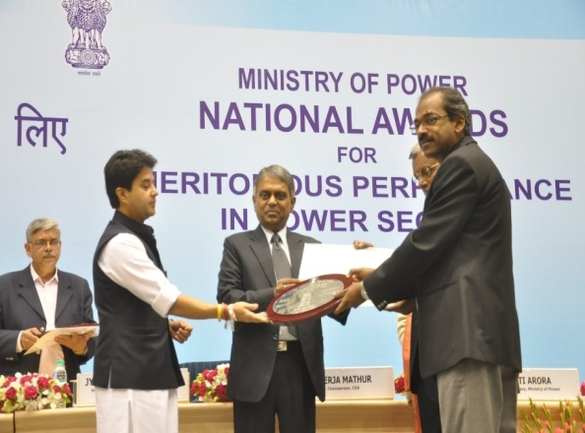
Awards and Recognitions
Ethisphere Institute – amongst World’s Most Ethical Companies 2014
CII-ITC Sustainability Award 2013
Energize Awards 2012-13 for Excellence in Power Distribution
Trombay – Annual Excellence in Energy Management Award
MACCIA Awards 2013 in Power and Energy Category
CEA Silver Shield Award

Slide 33
Website: www.tatapower.com
Email ID: md@tatapower.com
Contact No: +91 22 6665 8888

